Slide 1
付款函稿API(已編輯頁面)

Slide 2
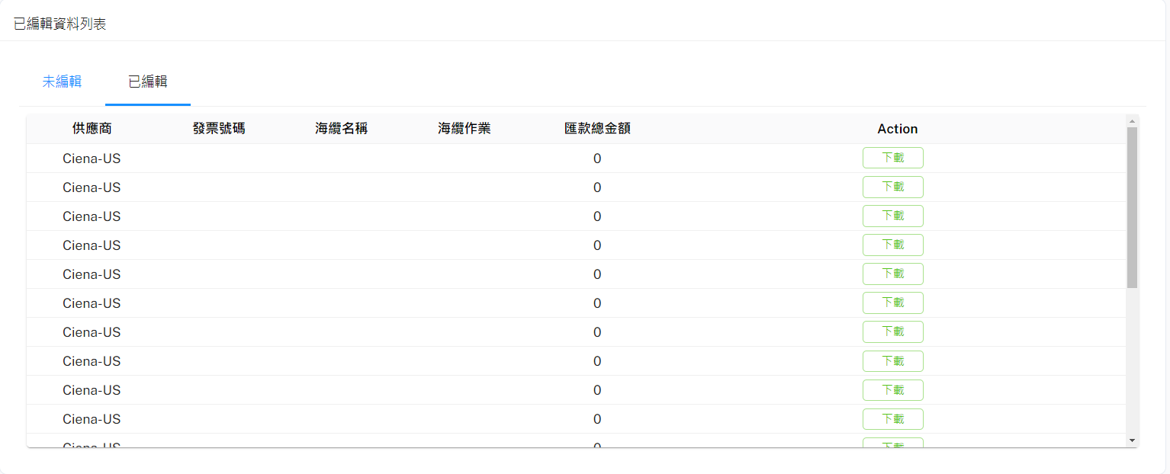
已編輯頁面API
URL: http://10.193.130.8:8000/api/v1/getPayDraftStream
Method: POST
POST Body:
{
"PayDraftID": int,
"DownloadTemplate": true
}
Method: GET
URL: http://10.193.130.8:8000/api/v1/paydraft/Status=COMPLETE&PayeeType=SUPPLIER

